Slide 1
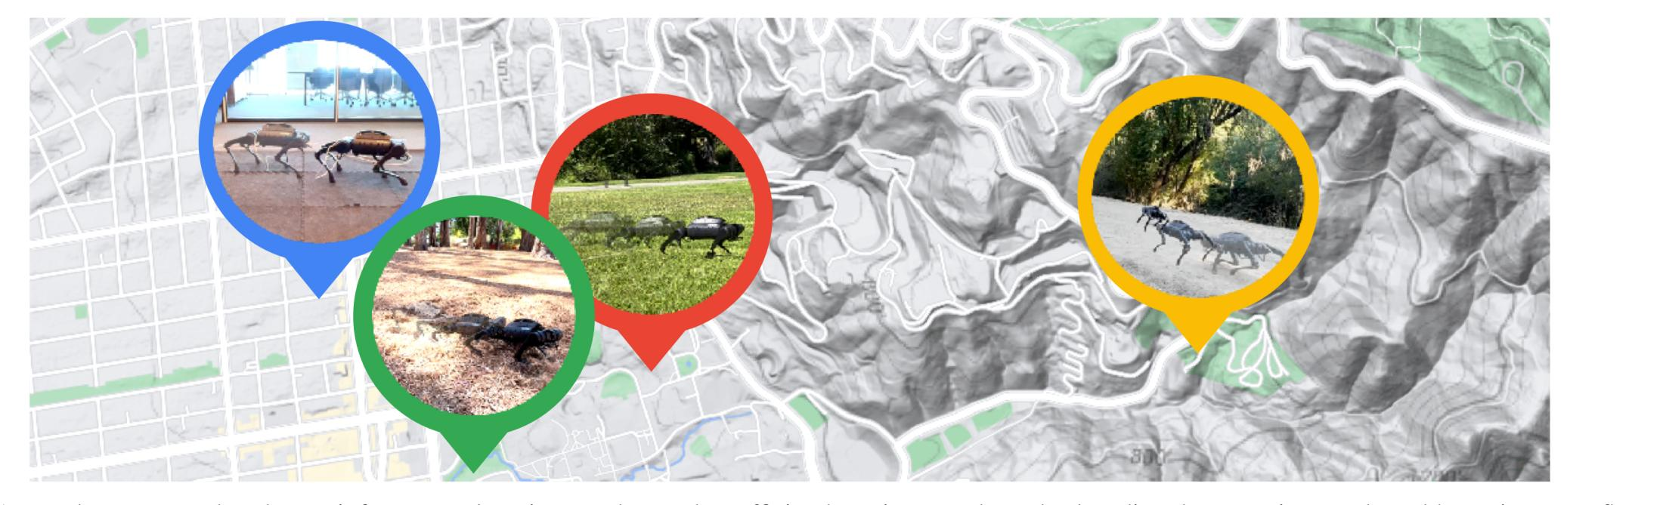
A Walk in the Park: Learning to Walk in 20 Minutes With Model-Free Reinforcement Learning
He Zhi, CSE of SYSU
Email: hezh58@mail2.sysu.edu.cn

Slide 2
Learning inefficiency
Regularization/Normalization

Slide 3
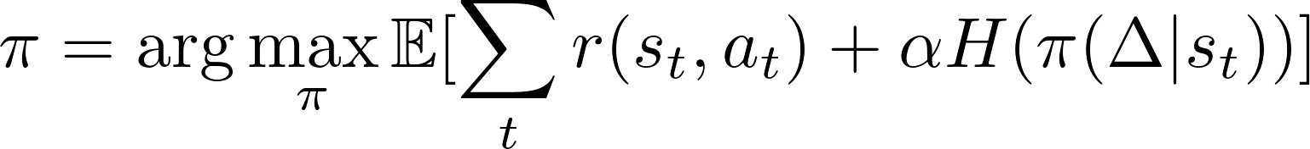


Preliminaries:SAC (soft actor critic)
A max-entropy DRL:
critic 1
s
target_critic 1
min
critic 2
actor
target_critic 2
target_actor

Slide 4
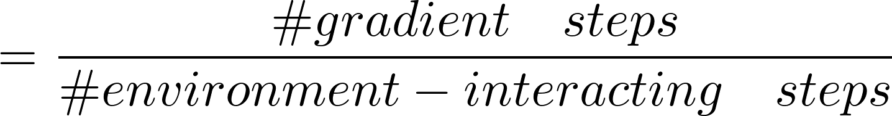
REDQ
UTD: Update-To-Data ratio
N: number of ensemble of Q networks
M: number of radomized sampling Q networks to minimise
G: number of updating epochs
《Randomized Ensembled Double Q-Learning: Learning Fast Without a Model》

Slide 5
REDQ
critic 1
target_critic 1
1
min
s
2
critic 2
.
.
.
.
.
.
(M samples, M < N)
target_critic 2
M
.
.
.
.
.
.
actor
target_actor
critic N
target_critic N

Slide 6
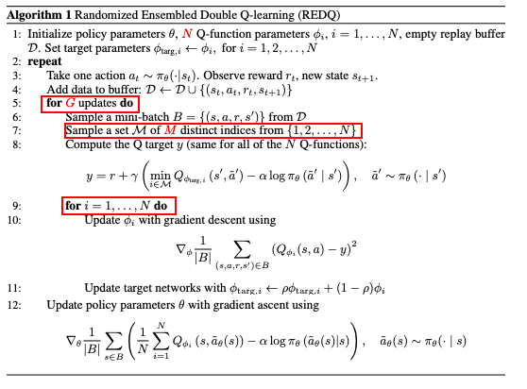
REDQ
SAC：G = 1，N = M = 2
UTD = 1
REDQ: G > 1, N > M >> 2
UTD = 20
《Randomized Ensembled Double Q-Learning: Learning Fast Without a Model》

Slide 7
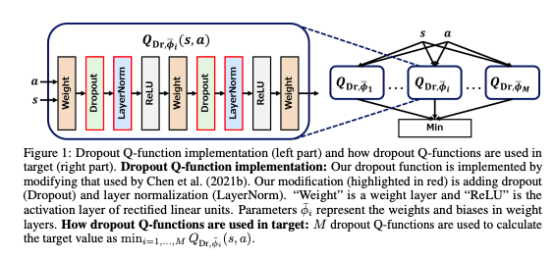
DroQ
small emsemble
dropout Q-network
《DROPOUT Q-FUNCTIONS FOR DOUBLY EFFICIENT REINFORCEMENT LEARNING》

Slide 8
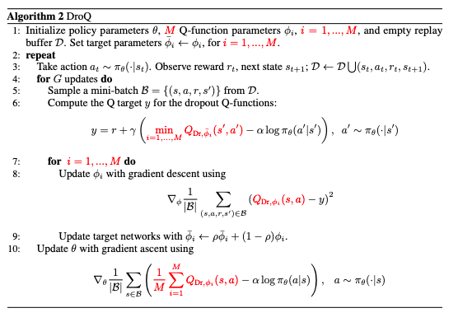
DroQ
《DROPOUT Q-FUNCTIONS FOR DOUBLY EFFICIENT REINFORCEMENT LEARNING》

Slide 9
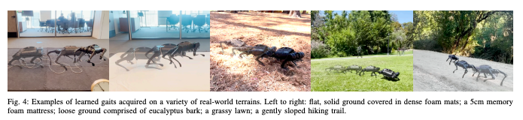
Experiment
SACs
REDQ
DroQ

Slide 10
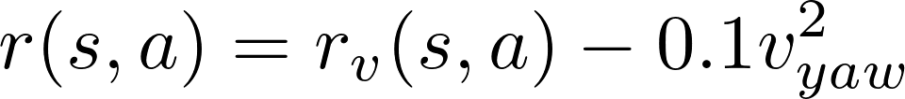
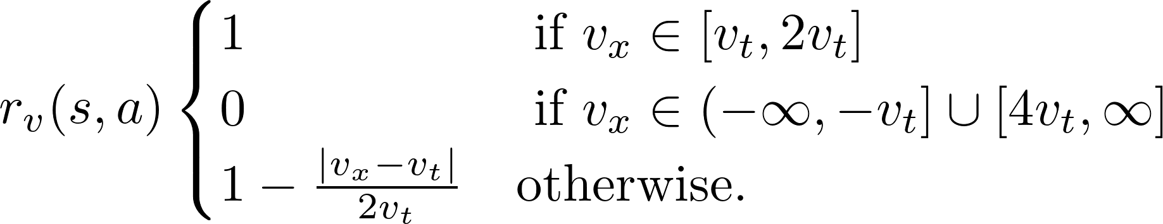


Experiment
state:
root orientation,
root angular velocity,
root linear velocity,
joint angles,
joint velocities,
binary foot contacts,
previous action,
...
action:
motor angles of joints for every leg
reward function:
: angular yaw velocity
: target velocity

Slide 11
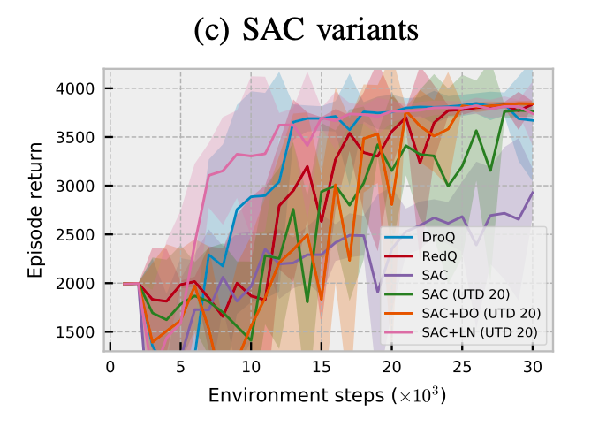
Result

Slide 12
Inspiration
UTD > 1
Dealing with bias of Q function learned
“REDQ has two critical components that allow it to maintain stable and near-uniform bias under high UTD ratios: an ensemble and in-target minimization.”
from 《RANDOMIZED ENSEMBLED DOUBLE Q-LEARNING: LEARNING FAST WITHOUT A MODEL》

